Slide 1

AtliQ Hospitality Analysis
UNIFIED MENTOR INTERNSHIP – PROJECT 3
BY
M POOJA

Slide 2

CONTENTS
INTRODUCTION
PROBLEM STATEMENT
METHODOLOGY USED
INFERENCES
CONCLUSION

Slide 3
INTRODUCTION
The hospitality analysis project aims to provide key insights and visualizations for a hotel management scenario. Leveraging data from various dimensions such as bookings, hotels, and rooms, the analysis covers essential aspects like revenue, occupancy, and customer ratings.
Through interactive widgets, the project facilitates dynamic filtering by properties, city, status, platform, month, and week. Visualizations include trends by week, occupancy by day type, and booking percentage by platform.
These insights empower hospitality professionals to make informed decisions and enhance revenue management strategies for their hotels. The project combines data analytics with visualization techniques to offer a comprehensive understanding of the business performance in the hospitality industry.

Slide 4
PROBLEM STATEMENT
Here's a concise problem statement for the hospitality analysis project:
In response to declining market share and revenue in the luxury/business hotels category, Atliq Grands, a prominent hotel chain, seeks to leverage Business and Data Intelligence for strategic decision-making.
With a lack of an in-house data analytics team, the objective is to engage a third-party service provider to analyze historical data.
The project focuses on filtering insights by properties, city, status, platform, month, and week. Key metrics such as revenue, occupancy percentage, and average ratings are to be visualized, offering trends by week, occupancy by day type, and booking percentage by platform.
This initiative aims to empower Atliq Grands with actionable insights to regain market share and revenue in the highly competitive hospitality industry."

Slide 5
METHODOLOGY USED
The methodology employed for the hospitality analysis project follows
a systematic approach to harness valuable insights from the provided datasets. Commencing with meticulous data collection from diverse dimensions including date, hotels, rooms, and bookings, the focus shifts to thorough exploration and cleaning processes, addressing missing values and ensuring data quality.
Interactive widgets are developed for dynamic filtering, enabling users to refine data based on properties, city, status, platform, month, and week.
Calculations are then performed to derive key metrics such as total revenue, occupancy percentage, and average ratings.
Subsequently, data visualization techniques, including line plots, bar charts, and pie charts, are employed to present trends by week, occupancy by day type, and booking percentage by platform. The methodology culminates in actionable insights and recommendations, documented for stakeholders, to inform strategic decision-making in the highly competitive hospitality industry.

Slide 6
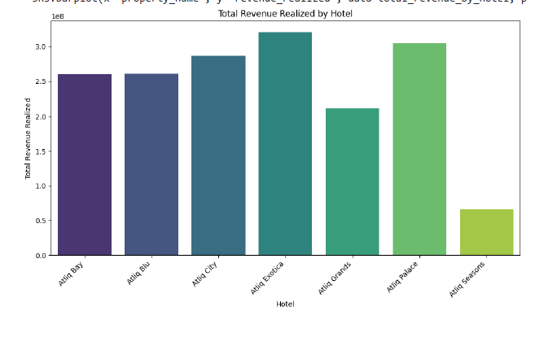
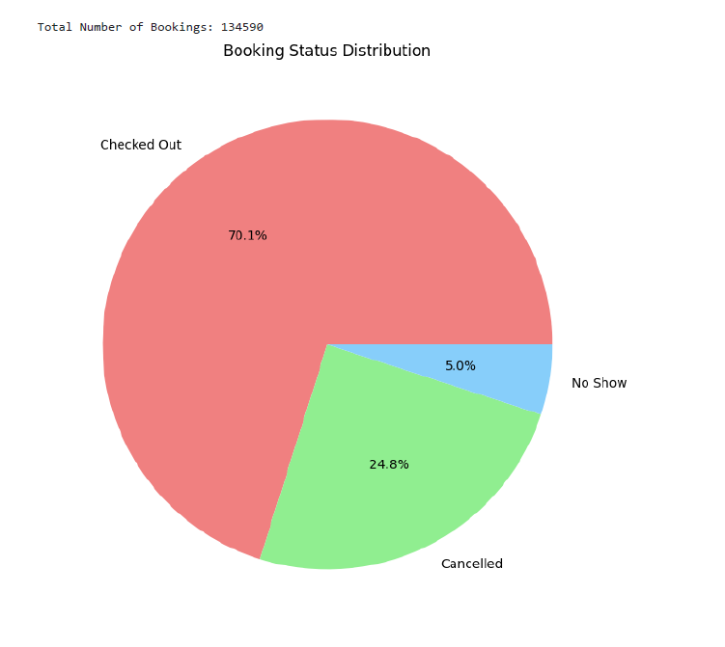
INFERENCES
Sum of revenue_realized
Booking Status Distribution

Slide 7
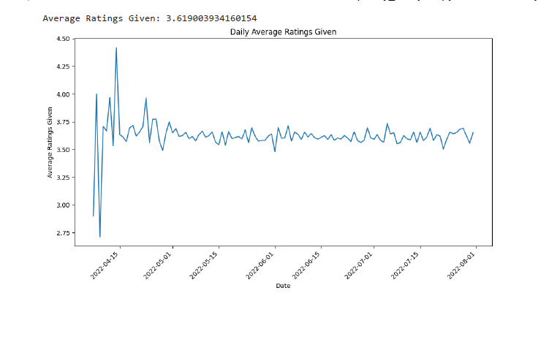
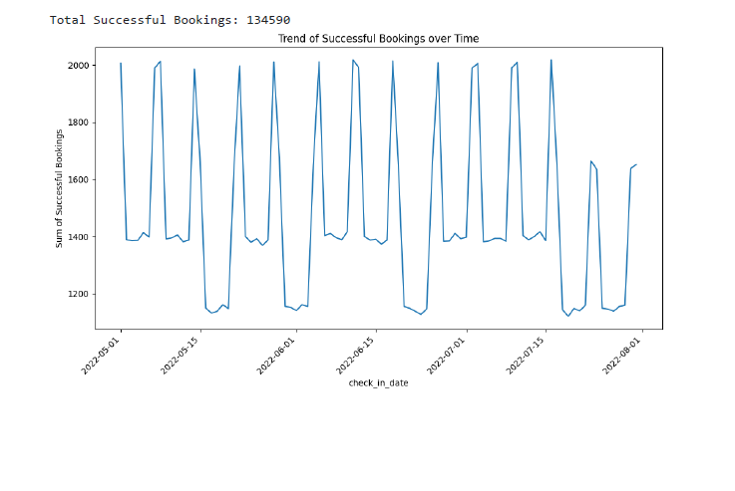
AVERAGE RATINGS
TOTAL SUCCESSFUL BOOKING

Slide 8
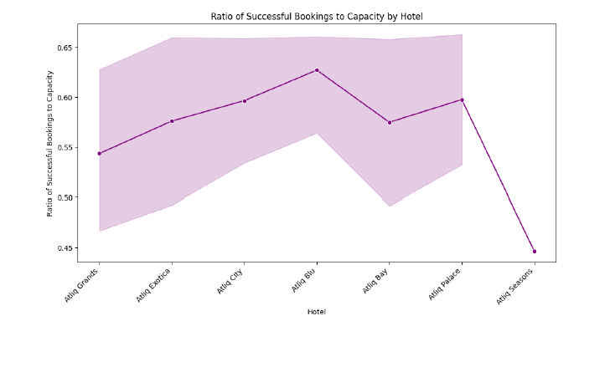

RATIO OF SUCCESSFUL BOOKINGS
COUNT OF CANCELLED BOOKING
RATIO OF TOTAL CANCLLED BOOKING

Slide 9
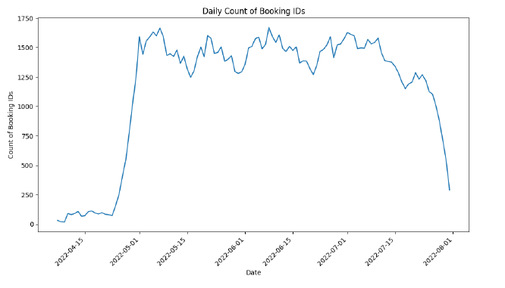
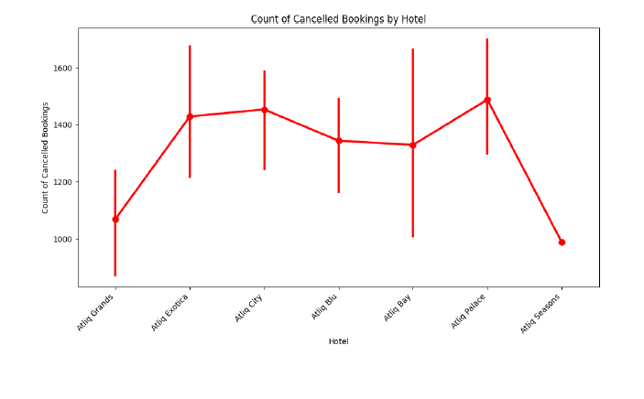
DAILY COUNT OF BOOKING IDs
COUNT OF CANCELLED BOOKINGS

Slide 10
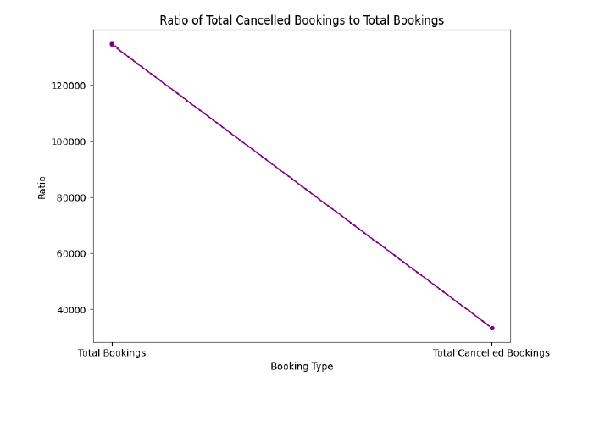
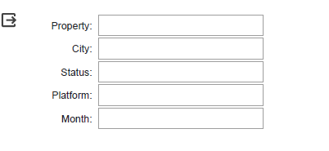
RATIO OF TOTAL CANCELLED BOOKINGS
FILTERS BY PROPERTIES,CITY,STATUS,PLATFORM,MONTH

Slide 11



CONCLUSION
In conclusion, the hospitality analysis project has successfully harnessed data-driven insights to illuminate crucial aspects of Atliq Grands' business performance.
Through comprehensive visualizations, the project has provided a nuanced understanding of revenue patterns, occupancy trends, and platform-specific booking behaviors. These insights serve as a foundation for strategic decision-making, enabling the hotel chain to revitalize its market share and revenue in the luxury/business hotels category.
The implementation of interactive widgets enhances user engagement, fostering a dynamic exploration of data tailored to specific criteria.
As we look to the future, there is significant potential for further refinement and expansion of this analytical framework. Integrating real-time data sources, incorporating advanced machine learning models, and exploring predictive analytics could unlock even deeper insights for proactive business strategies.
The hospitality industry is dynamic, and ongoing analysis will be crucial for Atliq Grands to stay agile, adapt to evolving trends, and maintain a competitive edge in the market.

Slide 12

Thank you
M POOJA
poojaofficial968@gmail.com
www.linkedin.com/in/pooja-m-083556284

